Slide 1

NightWatCh

Slide 2
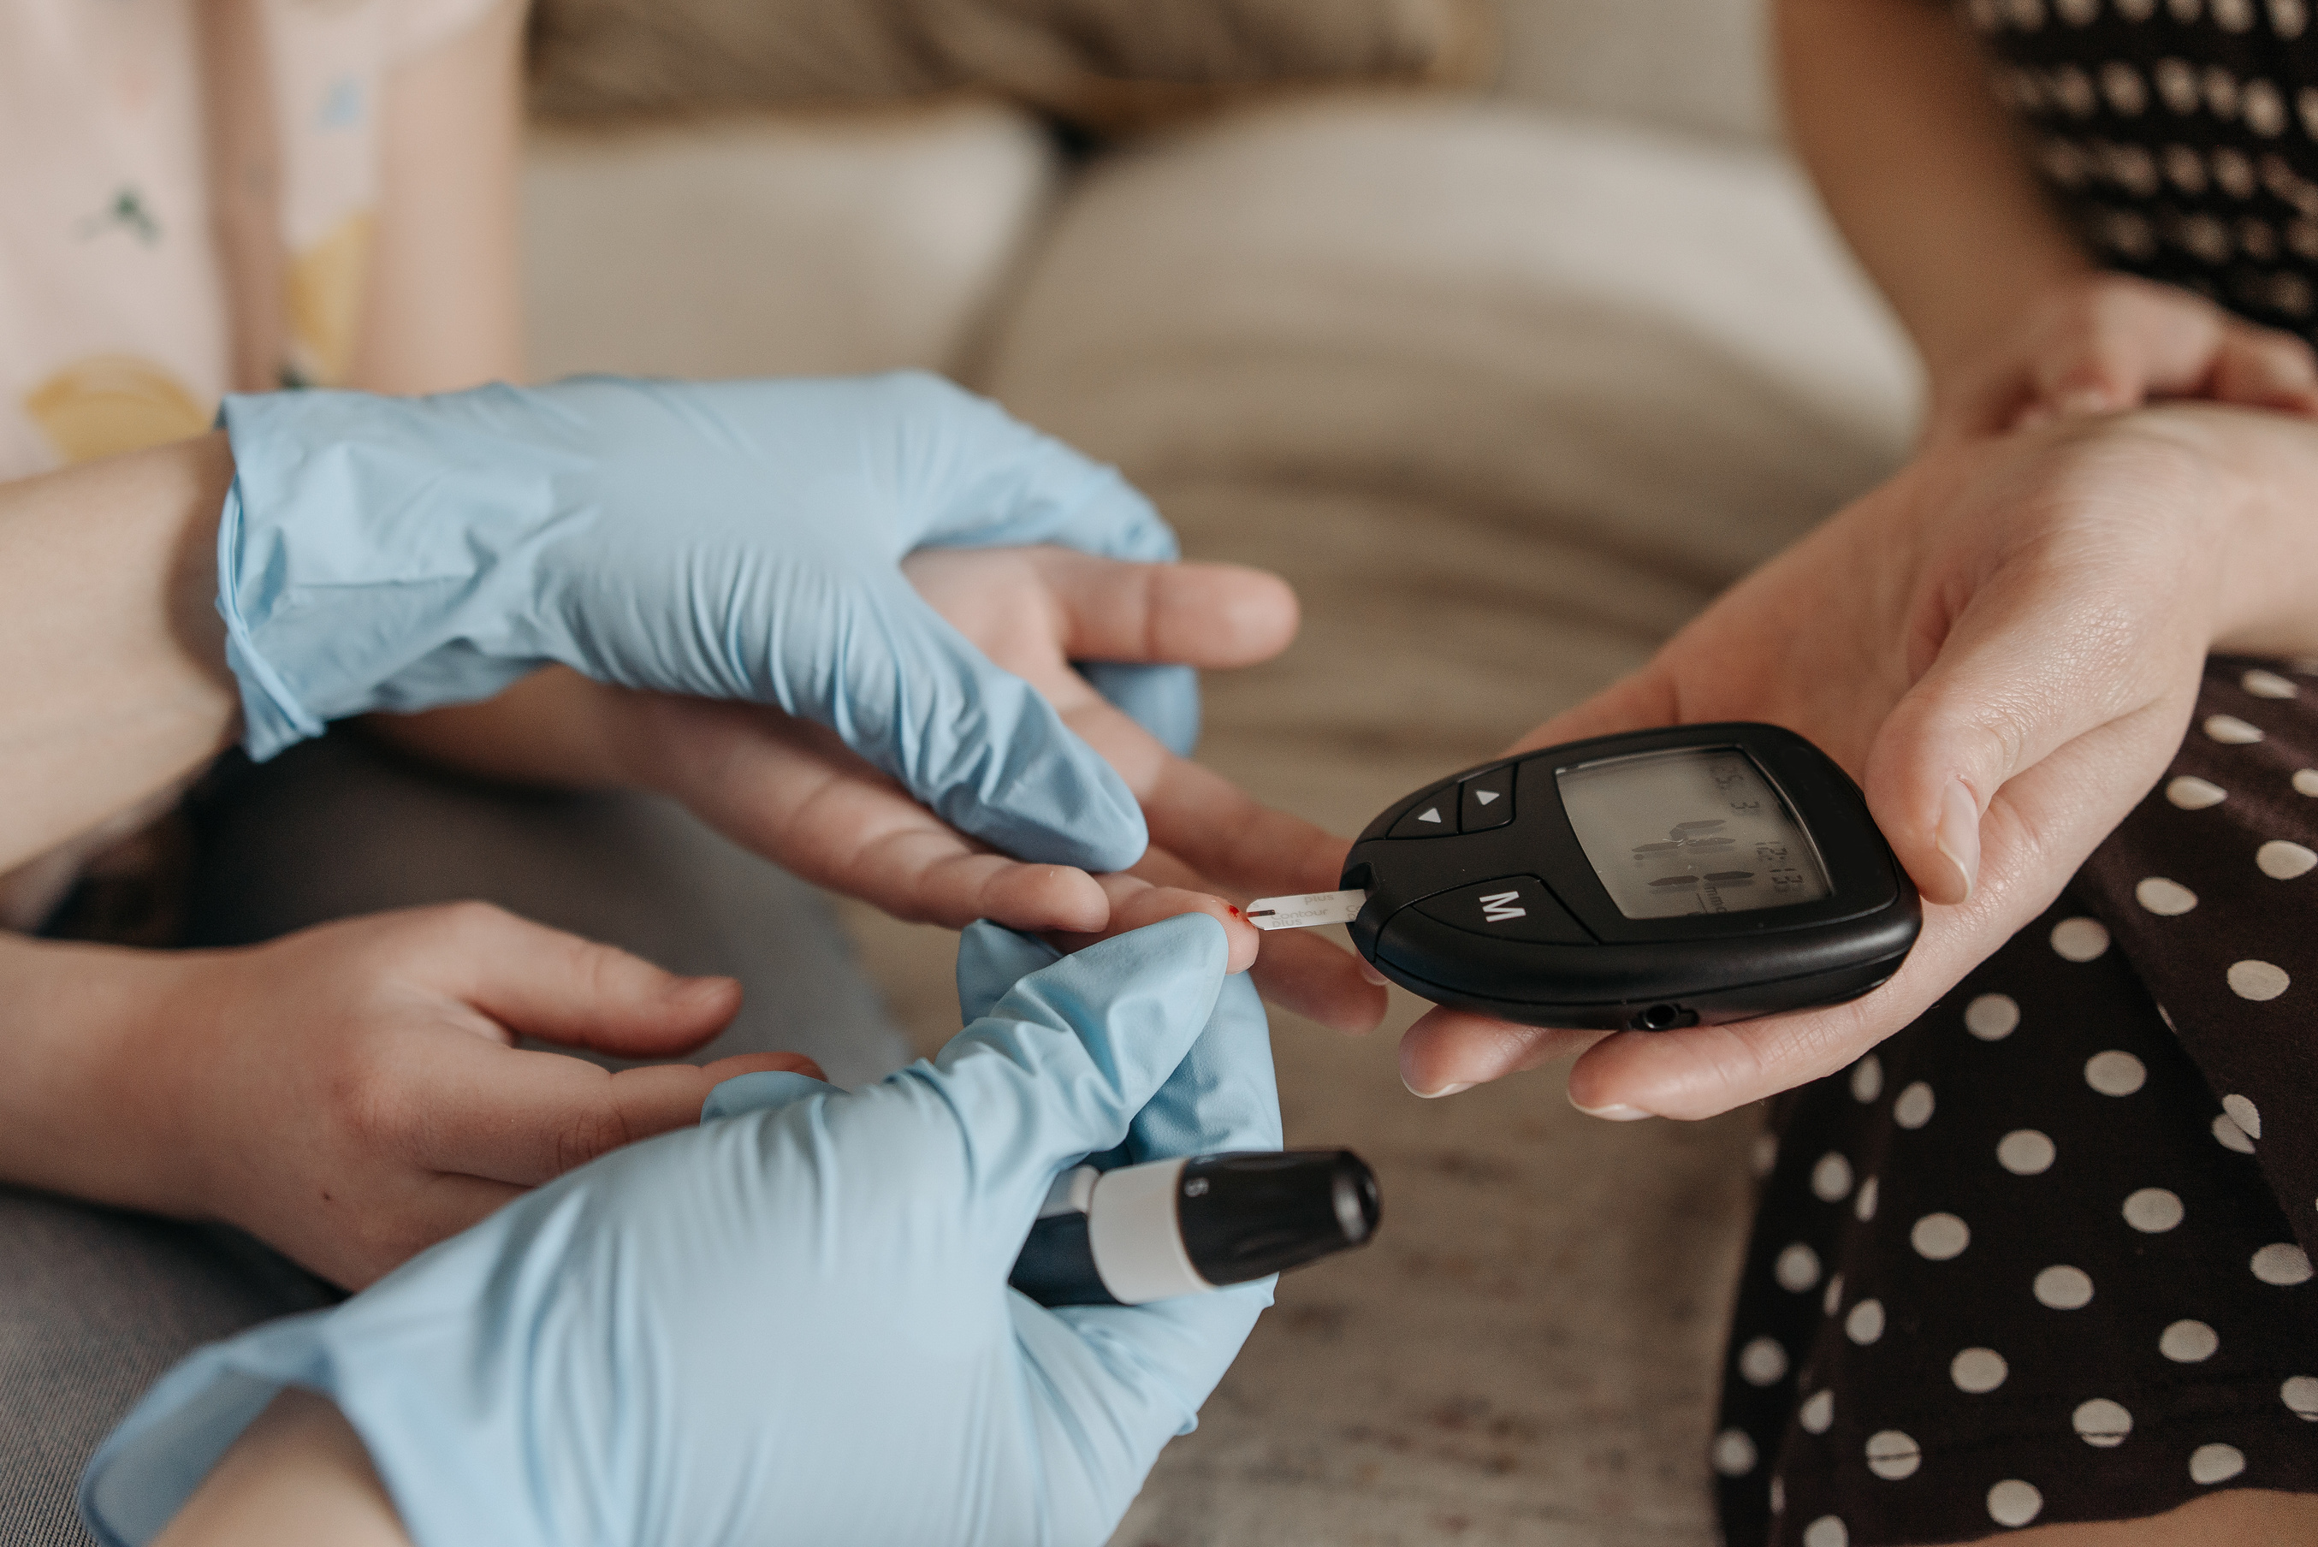
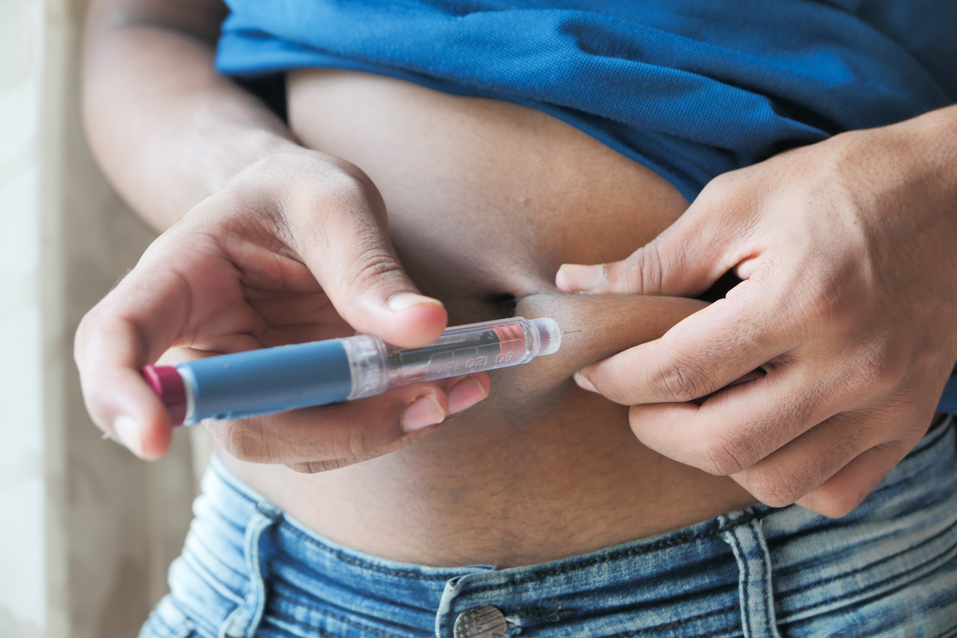


Slide 3


In 2019, diabetes
was the 9th leading cause
of death in the world.
573
MILLION
PATIENTS
WORLDWIDE

Slide 4
It is estimated that up to 50% of people with diabetes experience hypoglycemia at some point and it is estimated that nocturnal hypoglycemia may be responsible for up to 10% of deaths in people with diabetes.
The majority of people with diabetes live in low- and middle-income countries. In 2021, 78% of people with diabetes lived in these countries.

Slide 5

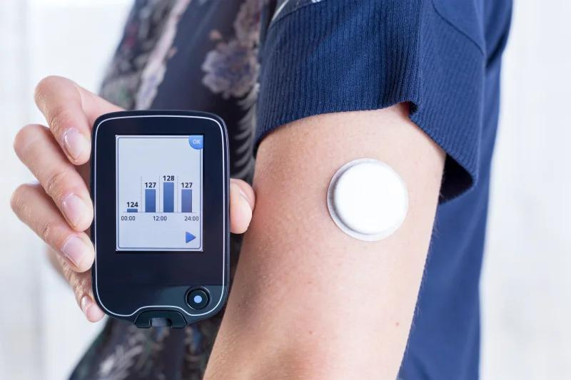
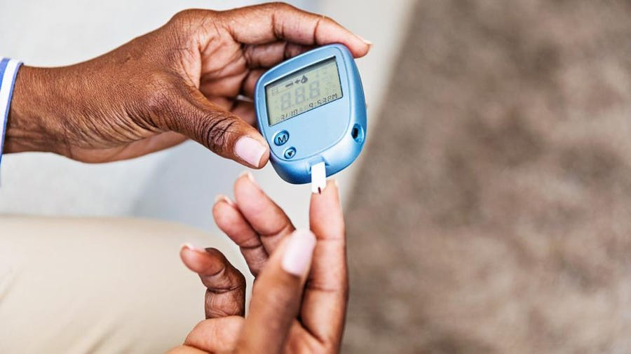


400,000 LKR
4000 LKR
0 LKR
Continuous Glucose Monitoring
Using an Available Glucometer
"JUST
SLEEP"

Slide 6


About Our
Affordable Diabetic Solutions For Everyone
Vision...

Slide 7

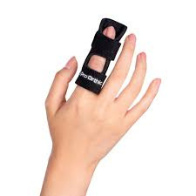






Why NightWatch?
We Provide Solutions.

Slide 8

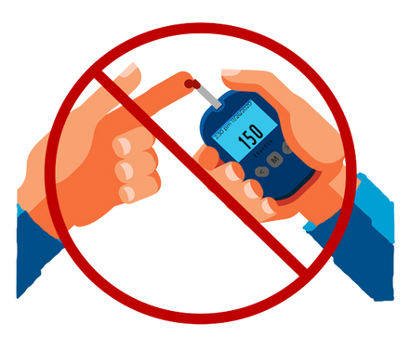






Non - invasive
Alarms the user
in case of
hypoglycaemia
Our Device
Our Device
Connect through Bluetooth with phone to indicate glucose levels.

Slide 9
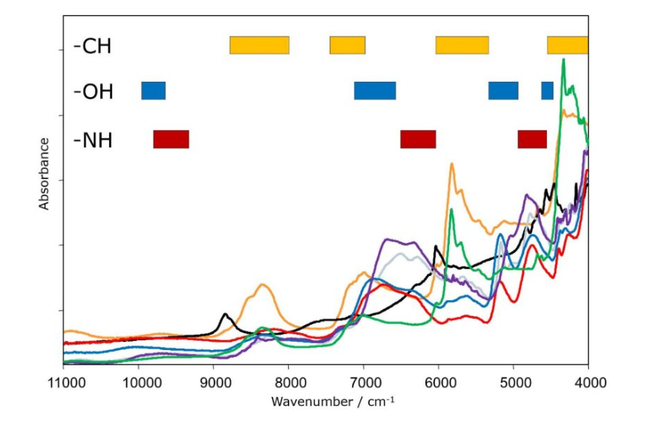
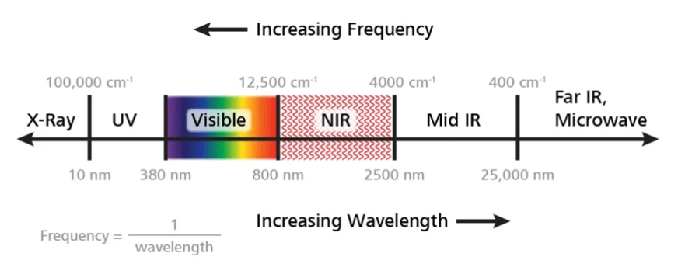
What is NIR?
Unveiling the Power of NIR Rays...

Slide 10
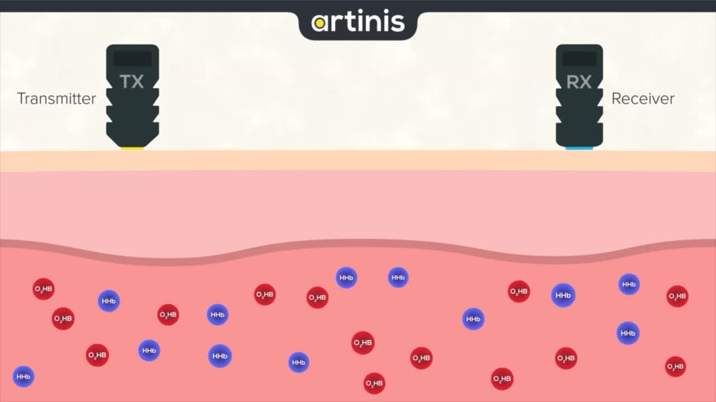
NIR Technology
Diffuse Reflectance Spectroscopy

Slide 11
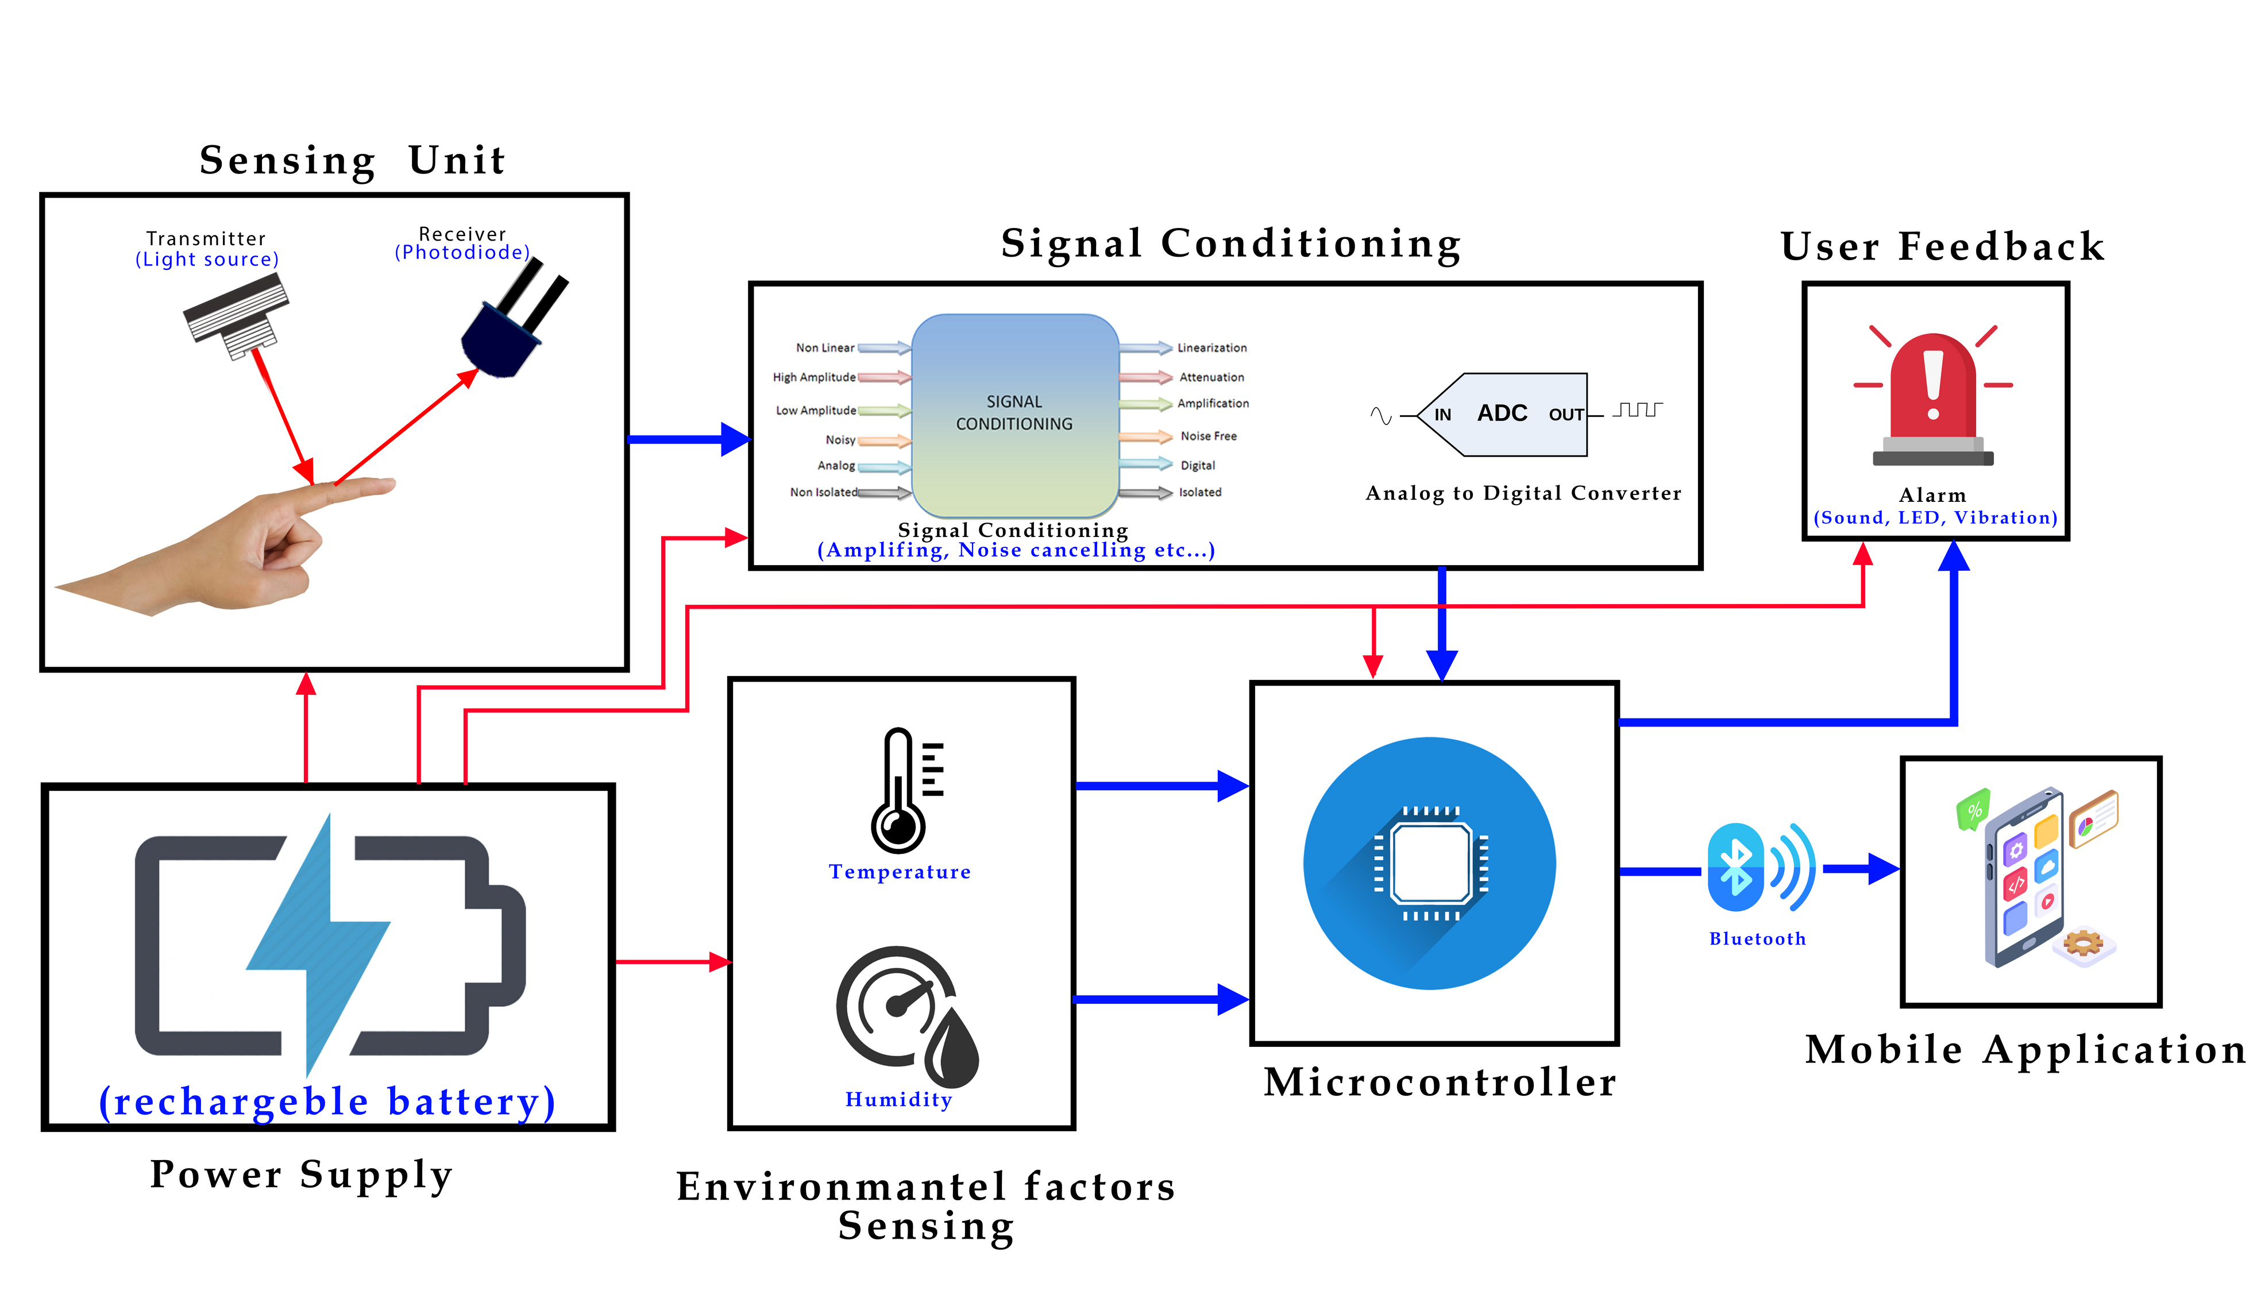
FUNCTIONAL BLOCK DIAGRAM

Slide 12


Proof of concept: Research Articles
1) Overview of NIR technology
Prospects and limitations of non-invasive blood glucose monitoring using near-infrared spectroscopy
Yadav et al. - Biomedical Signal Processing and Control – 2015
2) Overcoming attenuation problems, Poor Glucose Concentration and SNR problems using IR lasers
High snr glucose monitoring using a SWIR super- continuum light ... - islam. Available at: https://islam.engin.umich.edu/wp-content/uploads/sites/57/2017/12/glucose.pdf (Accessed: 06 June 2023).
3) Selecting proper NIR band for our device:
Hotmartua, R. et al. (2015) ‘Noninvasive blood glucose detection using near infrared sensor’, 2015 International Conference on Electrical Engineering and Informatics (ICEEI) [Preprint]. doi:10.1109/iceei.2015.7352586.
4) NIR diffuse reflectance spectroscopy
Maruo, K. et al. (2003) ‘in vivononinvasive measurement of blood glucose by near-infrared diffuse-reflectance spectroscopy’, Applied Spectroscopy, 57(10), pp. 1236–1244. doi:10.1366/000370203769699090.
5) baseline drift, is it a problem for our device ?
"A Comparative Study of Baseline Drift Removal Methods for ECG Signals" by Zhang et al. (2018) compares the performance of different baseline drift removal methods on ECG signals."

Slide 13





SDGs we
Achieve

Slide 14

Economic Impact
In the United States alone, the cost of diabetes is estimated to be $327 billion per year.
Global market for diabetes monitoring devices, including blood glucose meters, CGM systems, insulin pumps, and related products, is substantial. In 2020, the global diabetes care devices market was valued at approximately $27.8 billion.

Slide 15

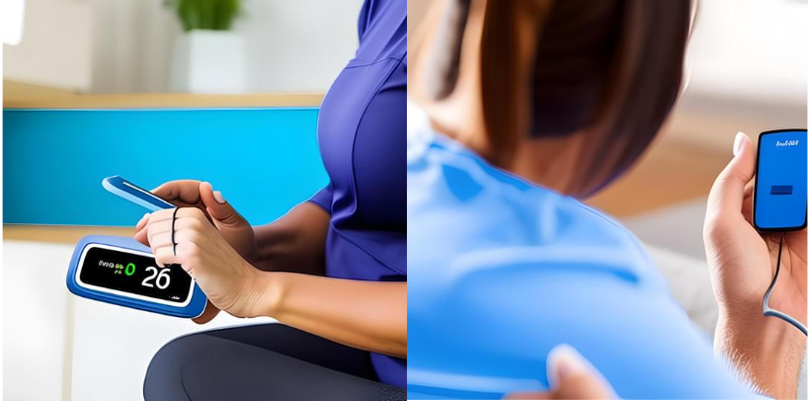

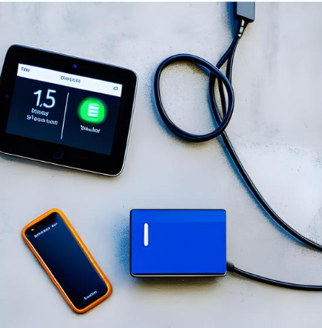
Different Consumers...
Different Market
Nocturnal hypoglycaemic patients
Hypoglycaemic patients
Diabetic patients
Hospitals

Slide 16

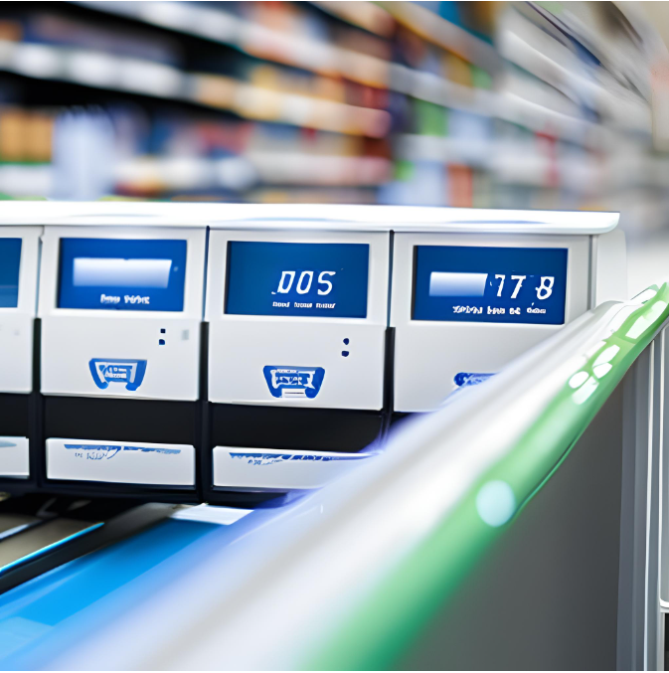
Business model
Prescription Product
Off the Shelf Product

Slide 17


Regulatory Approval
FDA approval : De Novo 510k Clearance

Slide 18
Our Budget
What about a solution under 100$?
Cheap...
But a reliable one...

Slide 19








Hansa
Marasinghe
Umesha Thilakarathna
Meet The Team
NIGHTWATCH
Ravindu
Pushpakumara
Vishagar
Arunan

Slide 20


Thank
You
Department of Electronic and Telecommunication, University of Moratuwa, Srilanka

